Slide 1
Water Pollution & Disease Predicting and Mapping Waterborne Risk
Charles Serafin & Kayla Vo
CPSC 322 – Fall 2025

Slide 2
Why Predict Waterborne Risk?
Unsafe water contributes to millions of preventable illnesses and deaths worldwide each year.
Many communities lack continuous or real-time water quality monitoring.
Machine learning can turn raw water quality measurements into simple, actionable risk labels (e.g., Safe / At-Risk).
Our goal: support early warning and better decision-making for water safety.

Slide 3
Dataset: Water Pollution & Disease (Kaggle)
Dataset: Water Pollution & Disease (Kaggle)
Unit of analysis: a single water sample with chemical, biological, and environmental measurements.
Number of instances: 3,000
Attribute types:
Numeric:
Contaminant Level (ppm)
Nitrate Level (mg/L)
Lead Concentration (µg/L)
Bacteria Count (CFU/mL)
pH Level
Dissolved Oxygen (mg/L)
Categorical:
Country
Region
Water Source Type
Water Treatment Method
Contaminated? (Yes / No)
Risk Level (Low / Medium / High), derived from WHO/EPA-inspired thresholds

Slide 4
Defining “Risk” and “Contamination”
Contaminated? (Yes / No)
True if a sample violates two or more WHO/EPA guideline thresholds:
Nitrate > 10 mg/L
Lead > 15 µg/L
Bacteria > 1000 CFU/mL
pH < 6.5 or > 8.5
Dissolved Oxygen < 5 mg/L
Contaminant Level > 5 ppm
Risk Level (Low / Medium / High)
Defined by number of total violations:
Low: 0–1 violations
Medium: 2–3 violations
High: 4+ violations

Slide 5
Data Challenges
The dataset contains no missing values, simplifying preprocessing.
Numeric attributes vary substantially (e.g., bacteria count has extreme outliers), affecting model behavior.
Categorical attributes required one-hot encoding for ML models.
The most conceptual challenge was aligning chemical measurements with WHO/EPA safety thresholds to generate meaningful labels.
Risk levels are imbalanced, especially Low vs High.

Slide 6
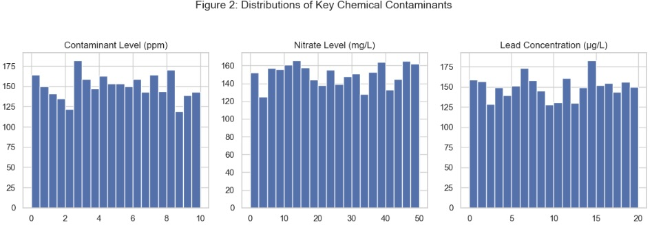
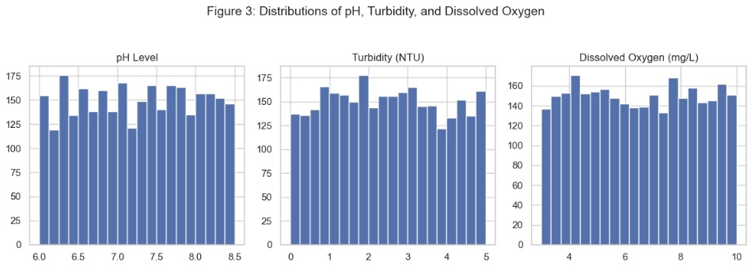
EDA: Histograms of Key Contaminants
The histograms show a wide range of contamination levels across samples, suggesting that multiple features, not a single dominant contaminant, are necessary for classification.

Slide 7
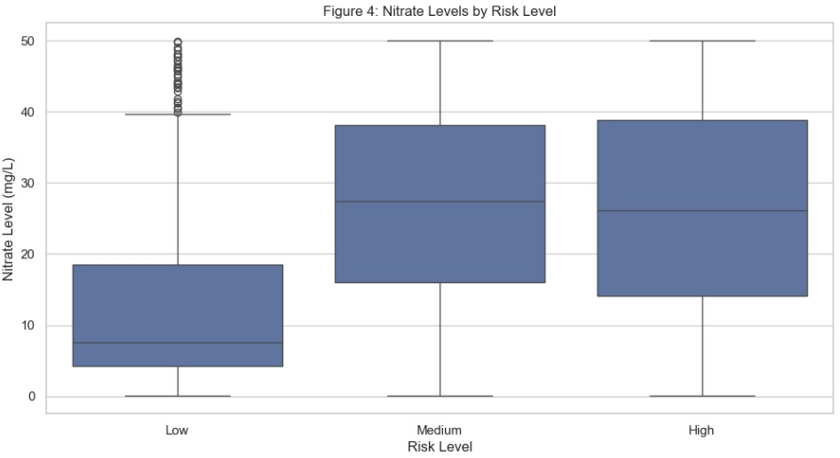
EDA: Boxplot of Nitrate Level by Risk Level
Higher nitrate concentrations are associated with Medium and High risk samples, while Low-risk samples generally stay near or below guideline thresholds. The spread and elevated medians indicate that nitrates meaningfully contribute to risk classification.

Slide 8
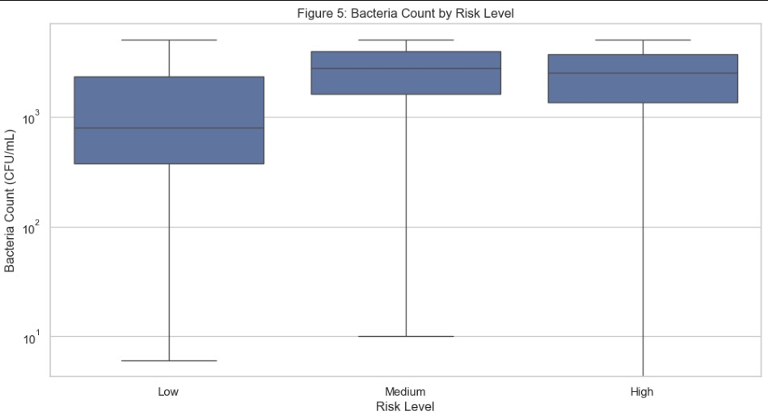
EDA: Boxplot of Bacteria Count by Risk Level
Because bacteria count is both skewed and strongly elevated in Medium and High categories, it serves as one of the most influential predictors of overall water-quality risk.

Slide 9
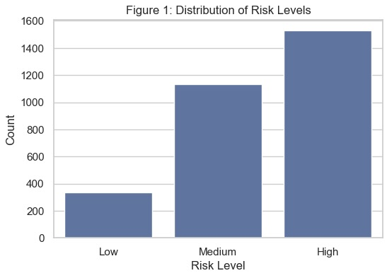
EDA: Risk Level Distribution
High: 1530
Medium: 1135
Low: 335
This indicates moderate imbalance, but NOT extreme imbalance.
Accuracy alone may still be misleading, so confusion matrices are necessary.

Slide 10
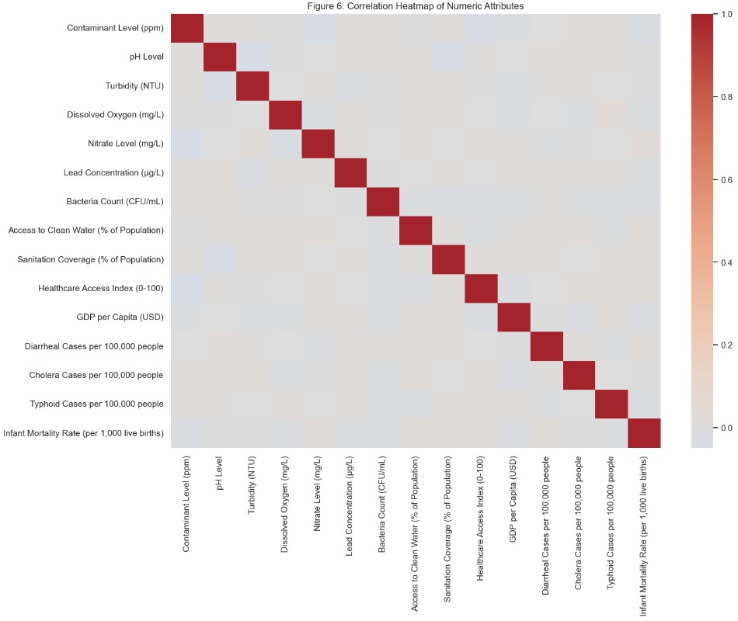
Correlation Heatmap
Most variables have weak correlations, suggesting each contributes unique information to classification.
Lead, nitrate, bacteria count, and contaminant level do not strongly correlate with one another, meaning multi-feature models like decision trees and random forests can benefit.

Slide 11
Preprocessing & Feature Engineering
Preprocessing Steps
No missing values → no imputation required
One-hot encoding for Country, Region, Water Source Type, and Treatment Method
Numeric features left unscaled (Decision Tree & Random Forest do not require scaling)
Stratified train/test split (2/3 train, 1/3 test)
Derived risk labels using WHO/EPA-inspired thresholds

Slide 12
Models Considered
Decision Tree (custom implementation)
K-Nearest Neighbors (k=5)
Custom Random Forest
Bootstrapped training sets
Random feature subsets
Select top-performing trees (M)
Majority vote prediction

Slide 13
Evaluation Strategy
Stratified train/test split (2/3 training, 1/3 testing)
Accuracy as primary metric
Confusion matrices for class-specific insight
For Random Forest:
Multiple runs for each parameter setting (N, M, F) due to randomness
Compare average accuracy
Identify best-performing configuration

Slide 14
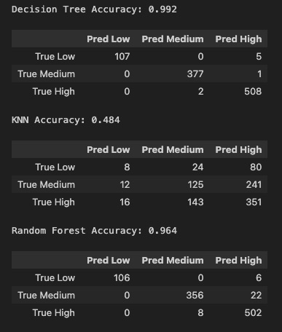
Model Comparison

Slide 15
Best Model: Custom Random Forest
Highest overall accuracy
Most stable across repeated runs
Lower misclassification for High-risk cases
Benefits from:
bootstrapping
feature randomness
ensemble averaging

Slide 16
Challenges & Future Directions
Some numeric variables (e.g., bacteria count) are highly skewed, complicating KNN and threshold labeling
Risk thresholds are simplified and may not capture true public-health risk
Class imbalance affects model evaluation
Future improvements:
Add scaling for KNN
Incorporate more advanced models (e.g., gradient boosting)
Explore dimensionality reduction (PCA)
Use cross-validation for more robust performance estimates

Slide 17
Data, References & Tools
Data
Water Pollution & Disease (Kaggle)
Technical References
WHO drinking-water guidelines
EPA water quality standards
Tools
Python, pandas, NumPy
Custom implementations of Decision Tree, KNN, and Random Forest
Jupyter Notebook for analysis and reporting
ChatGPT for a small amount of debugging

